Slide 1
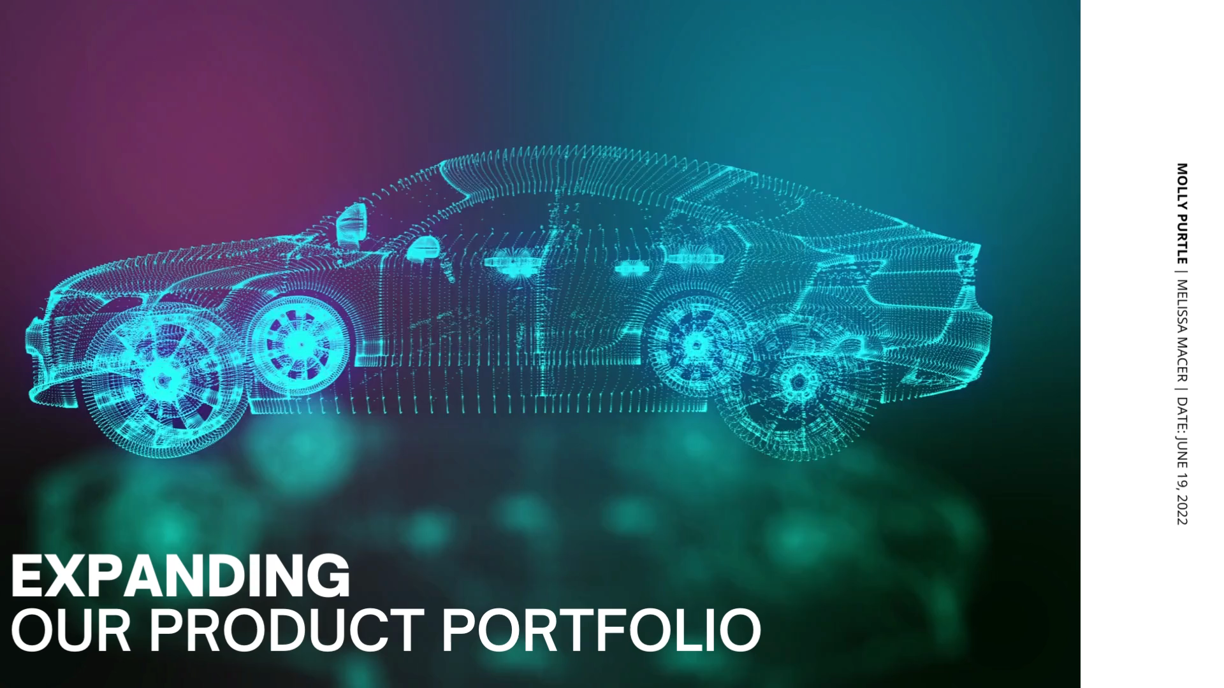
Notes:
Hello and welcome to my presentation on the diversification plan for our company. The purpose of this presentation is to present the recommendations and decisions made by our leadership team. I want to introduce the electric and hybrid vehicle industry into our company and the goal with this presentation is to help explain why it will be beneficial.

Slide 2
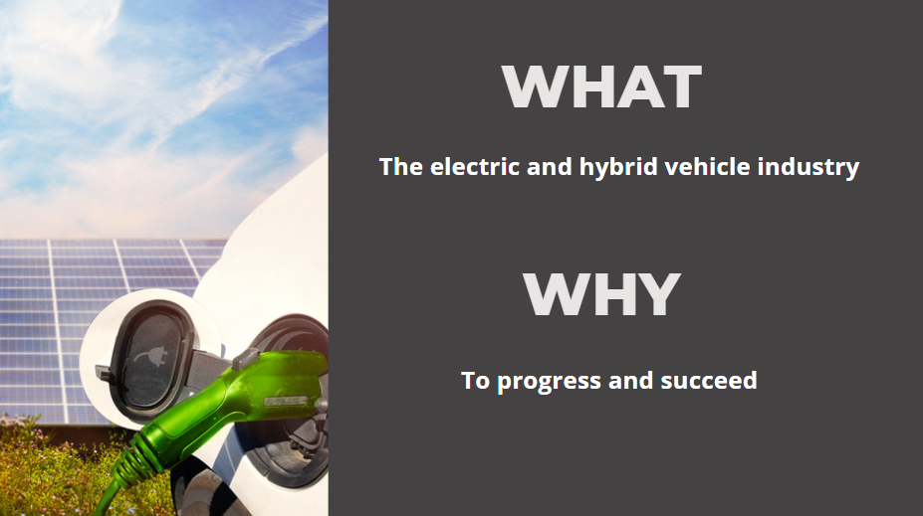
Notes:
I want to start by focusing on two key points: the ‘what’ and the ‘why’. The COVID-19 pandemic brought on unforeseeable challenges for companies everywhere. For the car manufacturing industry, competition has especially intensified. People are getting more and more concerned with the environment and gas prices are skyrocketing. The world is constantly changing. To succeed in a world of constant change, we need to adapt to our customers ever-changing preferences. That’s why our company needs to diversify and enter the electric and hybrid vehicle industry.

Slide 3
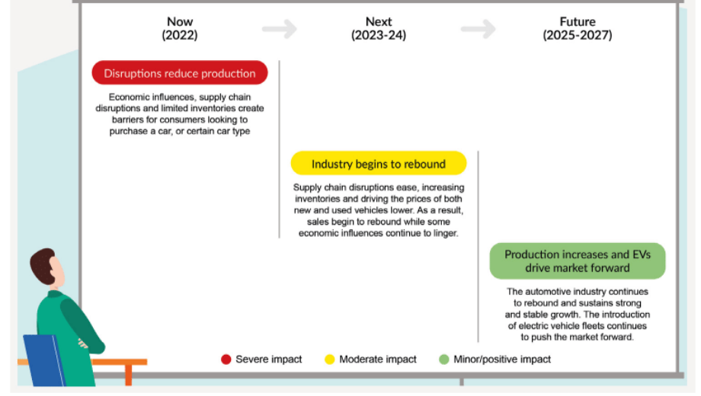
Notes:
This is just a brief run-down of where we are at right now, and where we are headed in the next 2-5 years. So again, we have an ever-changing world. The supply chain crisis, the COVID-19 pandemic, gas prices- it all contributes to each other. As we can see, the future of the auto manufacturing industry is almost reliant on electric vehicles. That’s what is expected to shift the auto industry back into a profitable field.

Slide 4
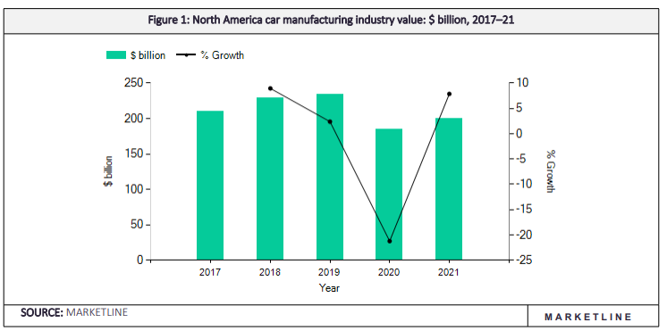
Notes:
The US automotive industry is worth $82.6 billion and growing at an annual growth rate of 7.22%, (Troncoso, 2022). This chart gives us a visual of what happened to us in 2020, you can see what a dip the auto manufacturing industry took. By 2021 though, we’re starting to see some rebound- but not a lot. U.S. sales are $15.3M as of 2022, and production is up 17% from 2021.

Slide 5

How are we doing right now?
Annual revenue: $104.2BN
Annual growth rate: -1.6%
Notes:
How are we doing right now? Well, here we can see that while annual revenue is $104.2 billion; our overall annual revenue growth rate is negative 1.6%. Why is this happening though? We can probably all agree that it's been pretty much a roller-coaster over the past two to three years, and the pandemic no doubt accelerated our industry's decline. The economy took a massive hit amid the pandemic, we know that. But even as we dig our way out, we’re starting to see a new trend: consumers are becoming more and more environmentally conscious.

Slide 6
“Which of the following factors impact your likelihood to purchase different car types?”
1. Price
2. Comfort
3. Fuel and energy efficiency
Notes:
A 2021 survey asked 1,208 participants, aged 18+, “Which of the following factors impact your likelihood to purchase different car types?" Price was the number one factor impacting car purchases: 74% of those who drive to work base their car buying on price. Comfort was the second highest factor for these consumers, making up 63% of the buying decision, and the third most important factor for these consumers is fuel and energy efficiency, making up 62% of the buying decision. Although economic conditions have really intensified consumers' price sensitivity, these consumers have begun to shift their car-buying conditions on value. So these top three factors here represent how consumers measure the value of a vehicle.
So, we've definitely touched on the electric and hybrid industry now several times, but I'd like to just briefly introduce the basics of this industry to you all.

Slide 7
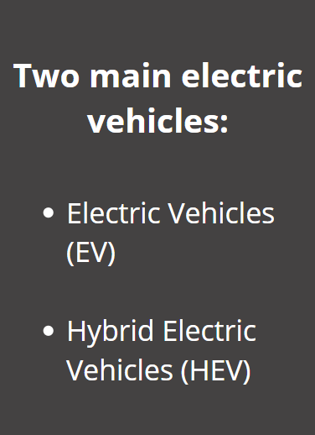
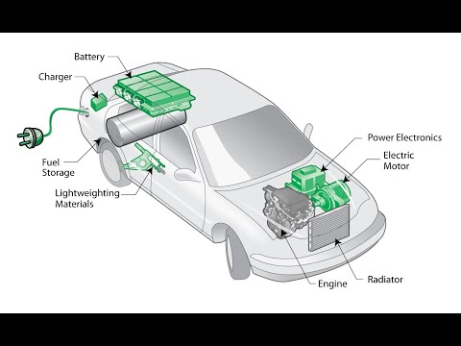
Notes:
The electric and hybrid vehicle industry in the United States produces primarily hybrid electric vehicles (HEV) and electric vehicles (EV). Electric vehicles (EV) run using an electric motor and have a battery instead of a gas tank. Hybrid electric vehicles (HEV) combine a traditional internal combustion engine system with an electric system. Hybrid vehicles typically come in two main types: regular and plug-in and use gas and electricity. This industry has a $17.5BN annual total revenue and a growth rate of 10.2%. Just to put this into perspective...

Slide 8
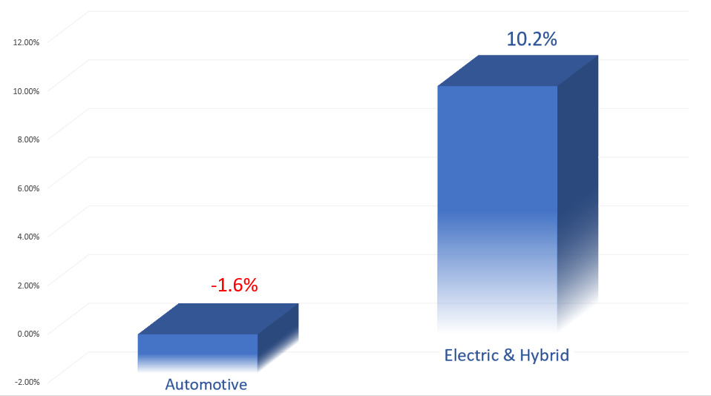
Notes:
These are our annual revenue growth percentage rates, side by side. On the left, the auto industry has a negative 1.6% annual growth rate. On the right, the electric and hybrid vehicle industry sees a positive 10.2% annual growth rate. The electric and hybrid vehicle industry annual market growth rate increased by 29.4% from 2017 to 2021 and is projected to increase by an additional 11.1% in the next five years. In contrast, gasoline operated engines have a $37.3BN annual total revenue which is down 3.3% since 2017 and only expected to increase in the next five years by 0.5%. It’s easy to see that our overall annual revenue is currently challenged, yet the electric and hybrid industry seems to be flourishing. Despite our industry's overall declining revenue, there’s a clear opportunity here for our company to diversify into an industry that will allow us to thrive among competitors.

Slide 9
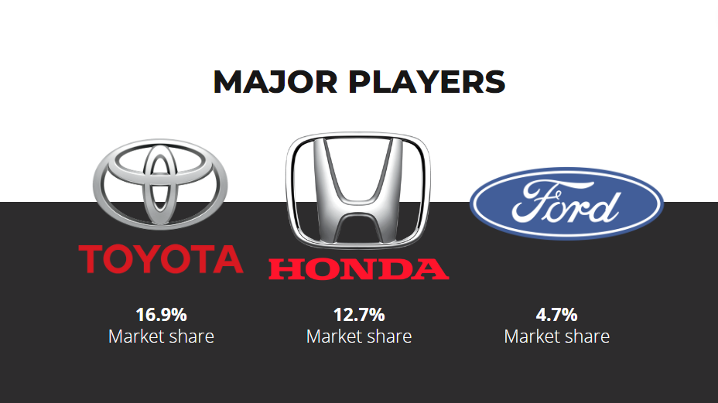
12.3%
20.4%
18.8%
Notes:
With the increase in competition, its vital that we consider what our competitors are doing. In particular, what they're doing right. Toyota and Honda have significant market share right now for the automobile industry as a whole. In the electric vehicle industry, Toyota shares 12.3% of the market, while Honda shares 20.4% and Ford shares 18.8%. The key player I want to focus on is Honda. Not only do they share 12.7% of the entire market, but they share 20.4% of the electric vehicle market- in other words, they’re dominating the auto industry from multiple angles.

Slide 10
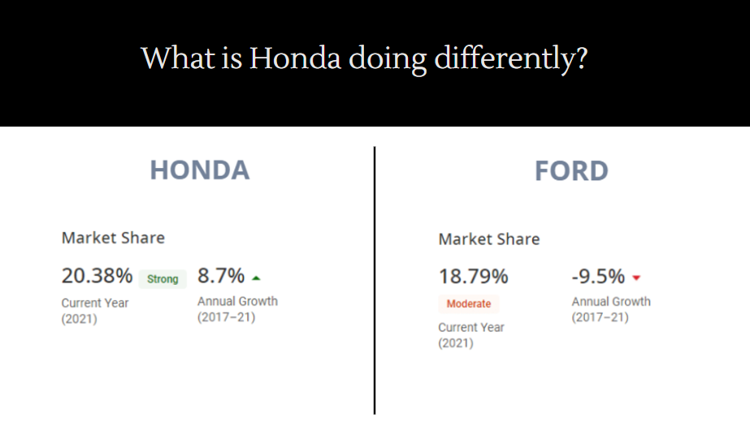
Notes:
Honda is considered an “All Star.” They not only have a strong market share, but their profit and revenue growth are considerable. Even viewing its close runner-up, Ford for comparison, we can see that although Ford has nearly similar market-share, their annual growth is down -9.5%. So, what is Honda doing differently? They utilize technology and research and development practices. For example, they established a Power Unit & Energy center and a Design center to help further their innovative research excellence. In January 2021, they launched three new scooter models with a Honda Enhanced Smart Power Plus engine to enhance environmental performance and high-output power.
Ford, on the other hand, has seen 20.9% drop in sales in the last year. In an effort to combat the decrease in sales, they announced in March of 2022 that they will be making an “aggressive push” into the electric vehicle industry. Their strategy is to split manufacturing teams into two divisions: the first will be focused on the electric and hybrid industry while the second will focus on maximizing cashflow from internal combustion engine vehicles and mitigating costs. What I believe is significant here, is to really look at Honda as a company that proves the potential of entering into the electric vehicle market.

Slide 11
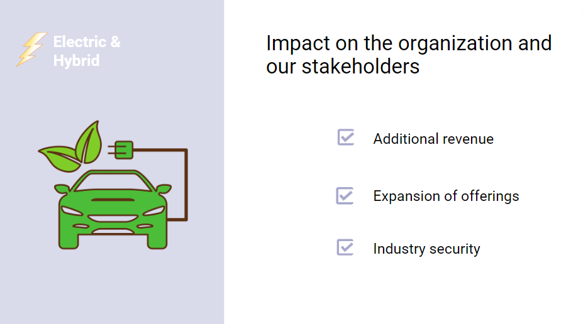
Notes:
As an automotive manufacturing company, we already provide many of the components necessary for electric and hybrid cars. Our employees also have the competencies and experience necessary to build these vehicles. This will give us another source of revenue, expand our offerings, and ultimately set us up with industry security in the event of another economic downfall.

Slide 12
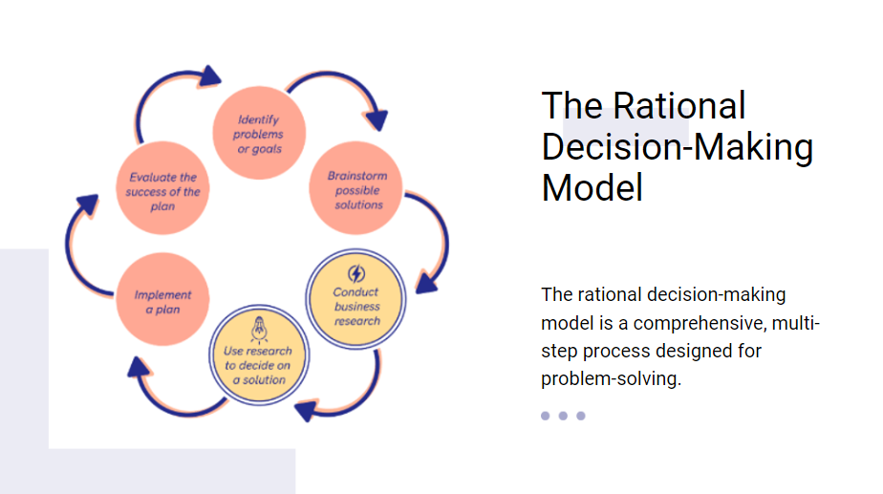
Notes:
Essentially, the rational decision-making model proposes alternative solutions along with research to help decide the best course of action. It is a comprehensive, multi-step process designed for problem-solving. Diversification is costly, which makes it even more crucial for our company to conduct careful research prior to making any final decisions. Time is on our side, so our company's diversification plan will follow this decision-making model.

Slide 13
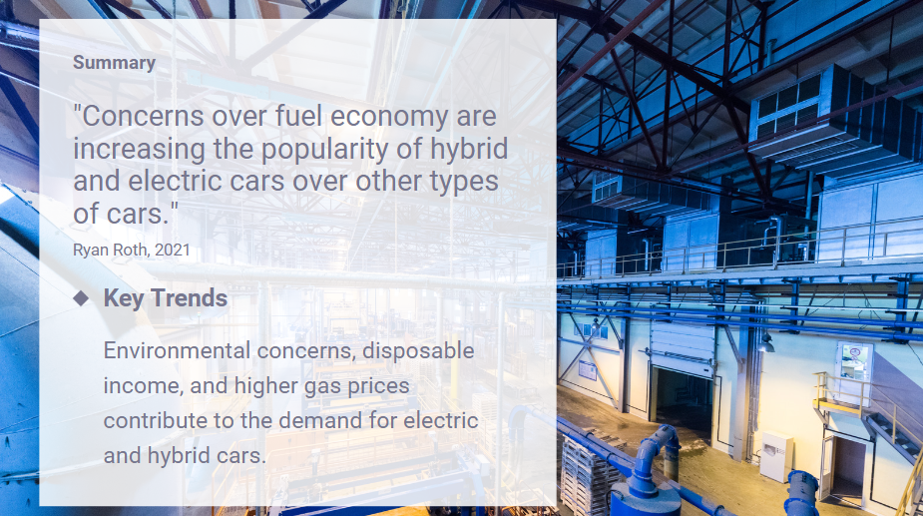
Notes:
This presentation was meant to convey key statistical analysis data points which provide valuable insight into our current industry performance, as well as where the opportunities lie. It's clear that our annual revenue growth is currently challenged and our company needs diversification in order to thrive among competitors. The hybrid and electric vehicle industry are rapidly growing in popularity, and the major players within the industry can either contribute their success to diversification into this industry, or are using it as a strategy to gain momentum after the auto industry's overall decline. Despite our industry's overall declining revenue, electric and hybrid vehicles present a significant opportunity for growth.

Slide 14
